Slide 1
Software Design - I

Slide 2


What is Achieved during design phase?
Transformation of SRS document to Design document:
A form easily implementable in some programming language.
SRS Document
Design Documents
Design Activities

Slide 3
Items Designed During Design Phase
Module structure,
Control relationship among the modules
call relationship or invocation relationship
Interface among different modules,
data items exchanged among different modules,
Data structures of individual modules,
algorithms for individual modules.

Slide 4
Module
A module consists of:
several functions
associated data structures.
D1 ..
D2 ..
Data
D3 ..
F1 ..
Functions
F2 ..
F3 ..
F4 ..
F5 ..

Slide 5
Module Structure

Slide 6
Iterative Nature of Design
Good software designs:
Seldom arrived through a single step procedure:
But through a series of steps and iterations.

Slide 7
Stages in Design
Design activities are usually classified into two stages:
Preliminary (or high-level) design
Detailed design.
Meaning and scope of the two stages:
vary considerably from one methodology to another.

Slide 8
High-level design
d1
d2
Identify:
modules
control relationships among modules
interfaces among modules.
d3
d1
d4

Slide 9
High-level design
The outcome of high-level design:
program structure, also called software architecture.

Slide 10
High-level Design
Several notations are available to represent high-level design:
Usually a tree-like diagram called structure chart is used.
Other notations:
Jackson diagram or Warnier-Orr diagram can also be used.
d1
d2
d3
d1
d4

Slide 11
Detailed design
For each module, design for it:
data structure
algorithms
Outcome of detailed design:
module specification.

Slide 12
A fundamental question
How to distinguish between good and bad designs?
Unless we know what a good software design is:
we can not possibly design one.

Slide 13
Good and bad designs
There is no unique way to design a software.
Even while using the same design methodology:
different engineers can arrive at very different designs.
Need to determine which is a better design.

Slide 14
What Is a Good Software Design?
Should implement all functionalities of the system correctly.
Should be easily understandable.
Should be efficient.
Should be easily amenable to change,
i.e. easily maintainable.

Slide 15
What Is Good Software Design?
Understandability of a design is a major issue:
Largely determines goodness of a design:
a design that is easy to understand:
also easy to maintain and change.

Slide 16
What Is a Good Software Design?
Unless a design is easy to understand,
Tremendous effort needed to maintain it
We already know that about 60% effort is spent in maintenance.
If the software is not easy to understand:
maintenance effort would increase many times.

Slide 17
How to Improve Understandability?
Use consistent and meaningful names
for various design components,
Design solution should consist of:
A set of well decomposed modules (modularity),
Different modules should be neatly arranged in a hierarchy:
A tree-like diagram.
Called Layering

Slide 18
Modularity
Modularity is a fundamental attributes of any good design.
Decomposition of a problem into a clean set of modules:
Modules are almost independent of each other
Based on divide and conquer principle.

Slide 19
Modularity
If modules are independent:
Each module can be understood separately,
reduces complexity greatly.
To understand why this is so,
remember that it is very difficult to break a bunch of sticks but very easy to break the sticks individually.

Slide 20
Layering
Superior
Inferior

Slide 21
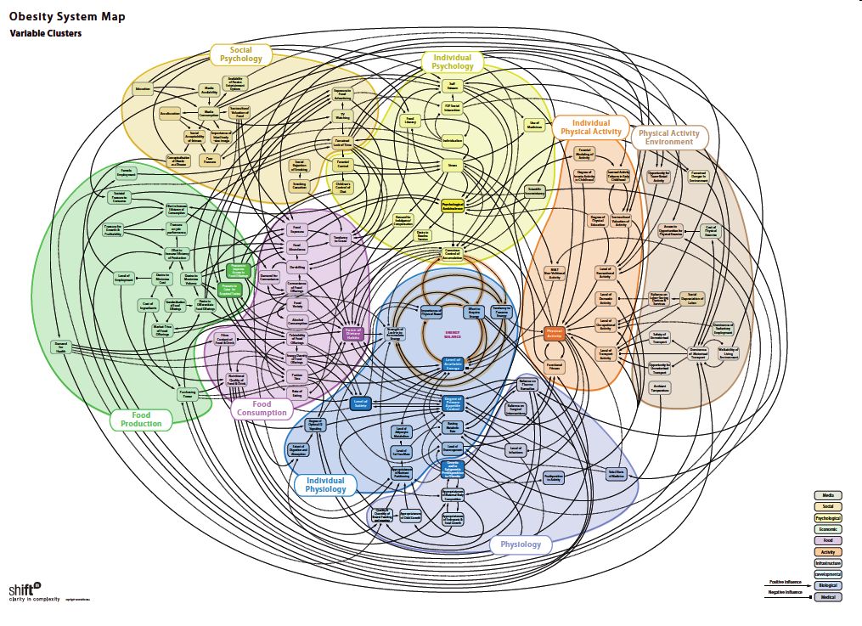
:Source
Bad design may look like this…

Slide 22
Modularity
In technical terms, modules should display:
high cohesion
low coupling.
We next discuss:
cohesion and coupling.

Slide 23
Modularity
Arrangement of modules in a hierarchy ensures:
Low fan-out
Abstraction

Slide 24
Coupling: Degree of dependence among components
High coupling makes modifying parts of the system difficult, e.g., modifying a component affects all the components to which the component is connected.
No dependencies
Loosely coupled-some dependencies
Source:
Pfleeger, S., Software Engineering Theory and Practice. Prentice Hall, 2001.
Highly coupled-many dependencies
Notes:
24

Slide 25
Cohesion and Coupling
Cohesion is a measure of:
functional strength of a module.
A cohesive module performs a single task or function.
Coupling between two modules:
A measure of the degree of interdependence or interaction between the two modules.

Slide 26
Cohesion and Coupling
A module having high cohesion and low coupling:
Called functionally independent of other modules:
A functionally independent module needs very little help from other modules and therefore has minimal interaction with other modules.

Slide 27
Advantages of Functional Independence
Better understandability
Complexity of design is reduced,
Different modules easily understood in isolation:
Modules are independent
No dependencies
Highly coupled-many dependencies

Slide 28
Why Functional Independence is Advantageous?
Functional independence reduces error propagation.
degree of interaction between modules is low.
an error existing in one module does not directly affect other modules.
Also: Reuse of modules is possible.
No dependencies

Slide 29
Reuse: An Advantage of Functional Independence
A functionally independent module:
can be easily taken out and reused in a different program.
each module does some well-defined and precise function
the interfaces of a module with other modules is simple and minimal.

Slide 30
Measuring Functional Independence
Unfortunately, there are no ways:
to quantitatively measure the degree of cohesion and coupling:
At least classification of different kinds of cohesion and coupling:
will give us some idea regarding the degree of cohesiveness of a module.

Slide 31
Classification of Cohesiveness
Classification can have scope for ambiguity:
yet gives us some idea about cohesiveness of a module.
By examining the type of cohesion exhibited by a module:
we can roughly tell whether it displays high cohesion or low cohesion.

Slide 32
Classification of Cohesiveness
functional
sequential
communicational
Degree of cohesion
procedural
temporal
logical
coincidental

Slide 33
Coincidental cohesion
The module performs a set of tasks:
which relate to each other very loosely, if at all.
That is, the module contains a random collection of functions.
functions have been put in the module out of pure coincidence without any thought or design.

Slide 34
Coincidental Cohesion - example
Module AAA{
Print-inventory();
Register-Student();
Issue-Book();
};

Slide 35
Logical cohesion
All elements of the module perform similar operations:
e.g. error handling, data input, data output, etc.
An example of logical cohesion:
a set of print functions to generate an output report arranged into a single module.

Slide 36
Logical Cohesion
module print{
void print-grades(student-file){ …}
void print-certificates(student-file){…}
void print-salary(teacher-file){…}
}

Slide 37
Temporal cohesion
The module contains functions so that:
all the functions must be executed in the same time span.
Example:
The set of functions responsible for
initialization,
start-up, shut-down of some process, etc.

Slide 38
init() {
Check-memory();
Check-Hard-disk();
Initialize-Ports();
Display-Login-Screen();
}
Temporal Cohesion – Example

Slide 39
Procedural cohesion
The set of functions of the module:
all part of a procedure (algorithm)
certain sequence of steps have to be carried out in a certain order for achieving an objective,
e.g. the algorithm for decoding a message.

Slide 40
Communicational cohesion
All functions of the module:
Reference or update the same data structure,
Example:
The set of functions defined on an array or a stack.

Slide 41
Communicational Cohesion
handle-Student- Data() {
Static Struct Student-data[10000];
Store-student-data();
Search-Student-data();
Print-all-students();
};
Function A
Function B
Function C
Communicational
Access same data

Slide 42
Sequential cohesion
Elements of a module form different parts of a sequence,
output from one element of the sequence is input to the next.
Example:
sort
search
display

Slide 43
Functional cohesion
Different elements of a module cooperate:
to achieve a single function,
e.g. managing an employee's pay-roll.
When a module displays functional cohesion,
we can describe the function using a single sentence.

Slide 44
Determining Cohesiveness
Write down a sentence to describe the function of the module
If the sentence is compound,
it has a sequential or communicational cohesion.
If it has words like “first”, “next”, “after”, “then”, etc.
it has sequential or temporal cohesion.
If it has words like initialize,
it probably has temporal cohesion.

Slide 45
Thank You!!

